Slide 1
Getting Faculty to use Cascade CMS
Joey Peterson
Web Developer
Joey.Peterson@csus.edu

Slide 2
Campus Information
30,000+ Students
1,000+ Faculty
800+ Cascade CMS Users

Slide 3
Faculty are good at a lot of things…. Just not web design!

Slide 4
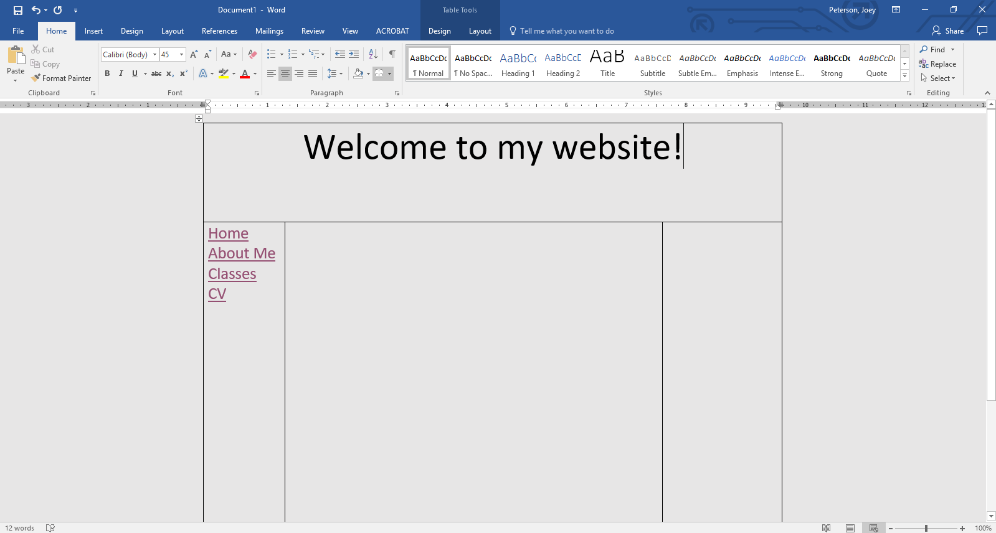
example

Slide 5
Website Requirements
Accessible
Follows Campus Identity Guide
Maintainability
Searchable

Slide 6
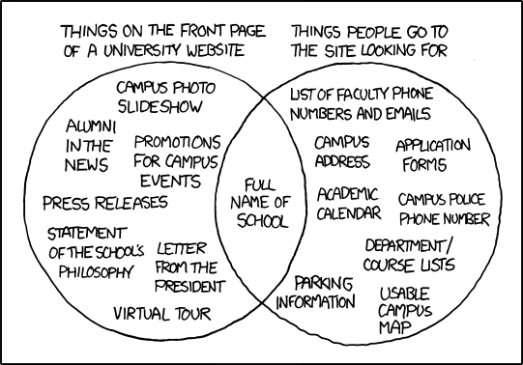
Solution
Shared header/footer
Shared CSS/JS libraries
Shared template
Data definition to make it simple for faculty to highlight common information
Backups
Source: https://www.xkcd.com/773/

Slide 8
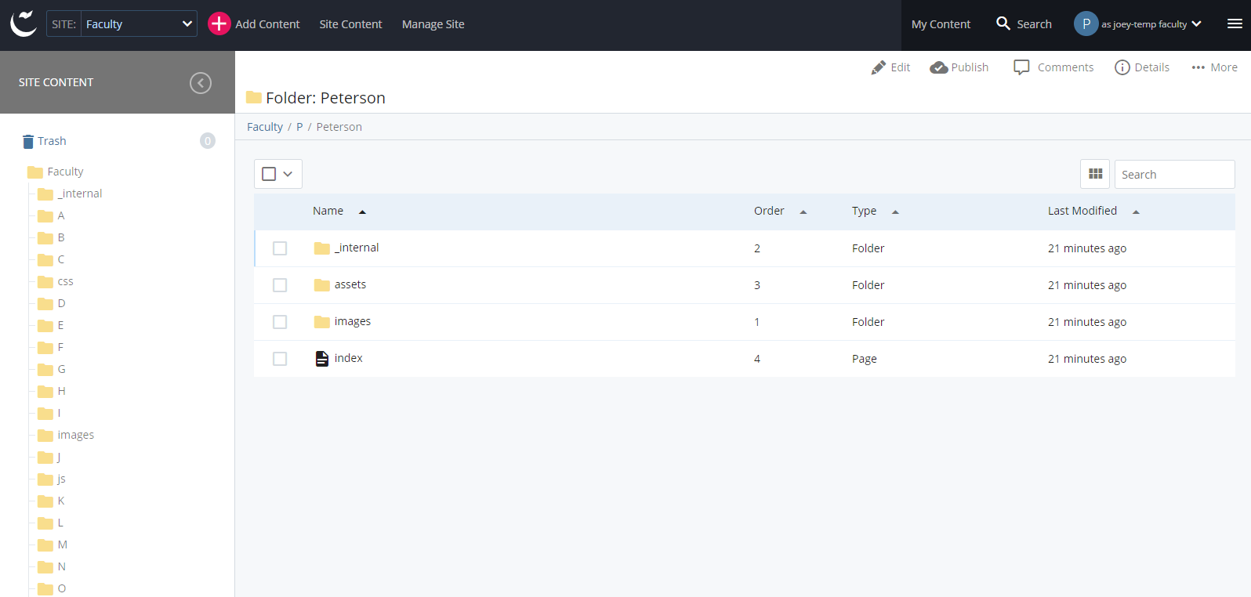

Slide 9
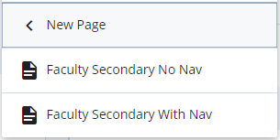
Adding Content
Only option is to
Add file
Add folder
Create secondary page

Slide 10
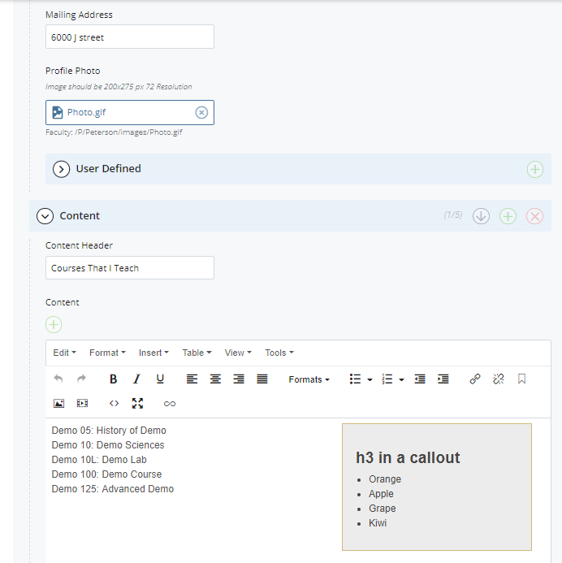
Homepage Data Definition

Slide 11
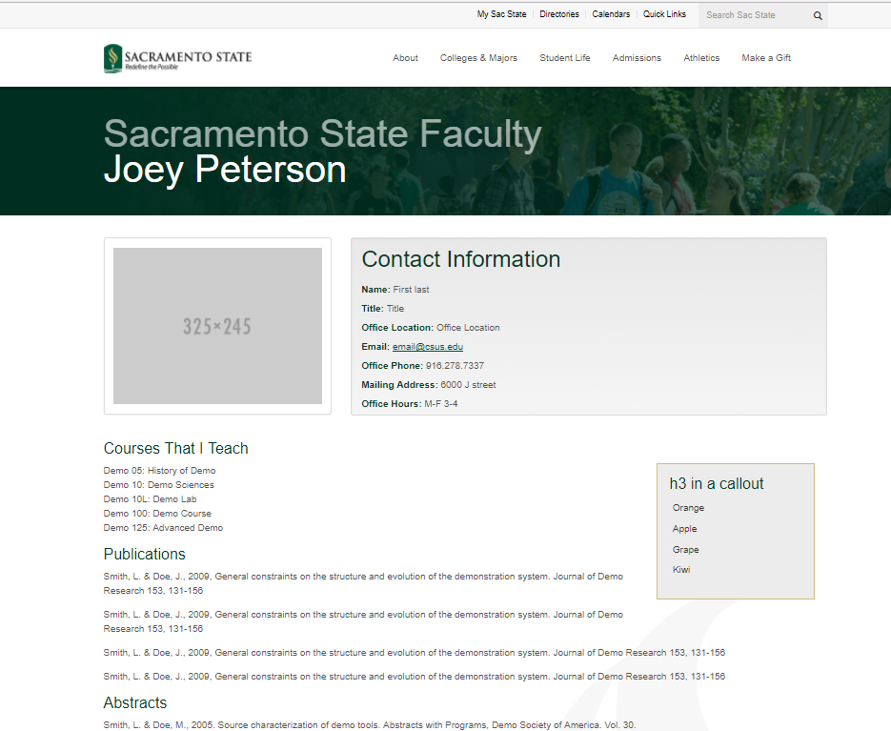

Slide 12
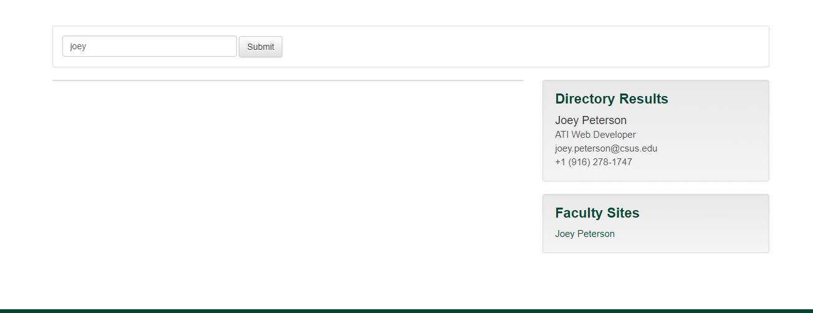
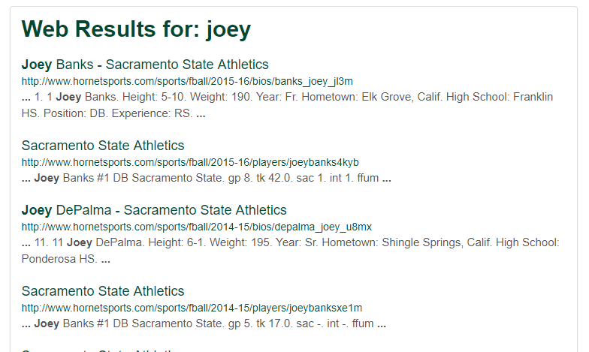
Search
Faculty sites are highlighted in search via Cascade XML Block

Slide 13
Individual Training
Training with the same group that provides LMS support
Faculty member comes with documents, images, and other media
Website complete by the end of the training

Slide 14
Workshop
Cascade Overview
Accessibility importance
Hands-on demo
90 minute training (or less depending on group)
Offered Monthly

Slide 15
Training Site
24/7 Help
View different blocks
“Advanced” features
Step by Step Guide
Site: http://csus.edu/cascade/training/

Slide 16
Joey Peterson Web Developer Joey.Peterson@csus.edu

