Slide 1
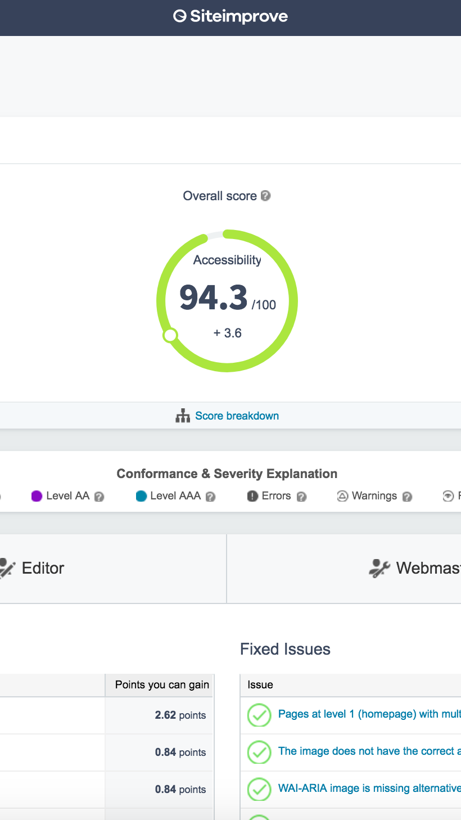
how to make your site accessible & maintain it
accessibility

Slide 2
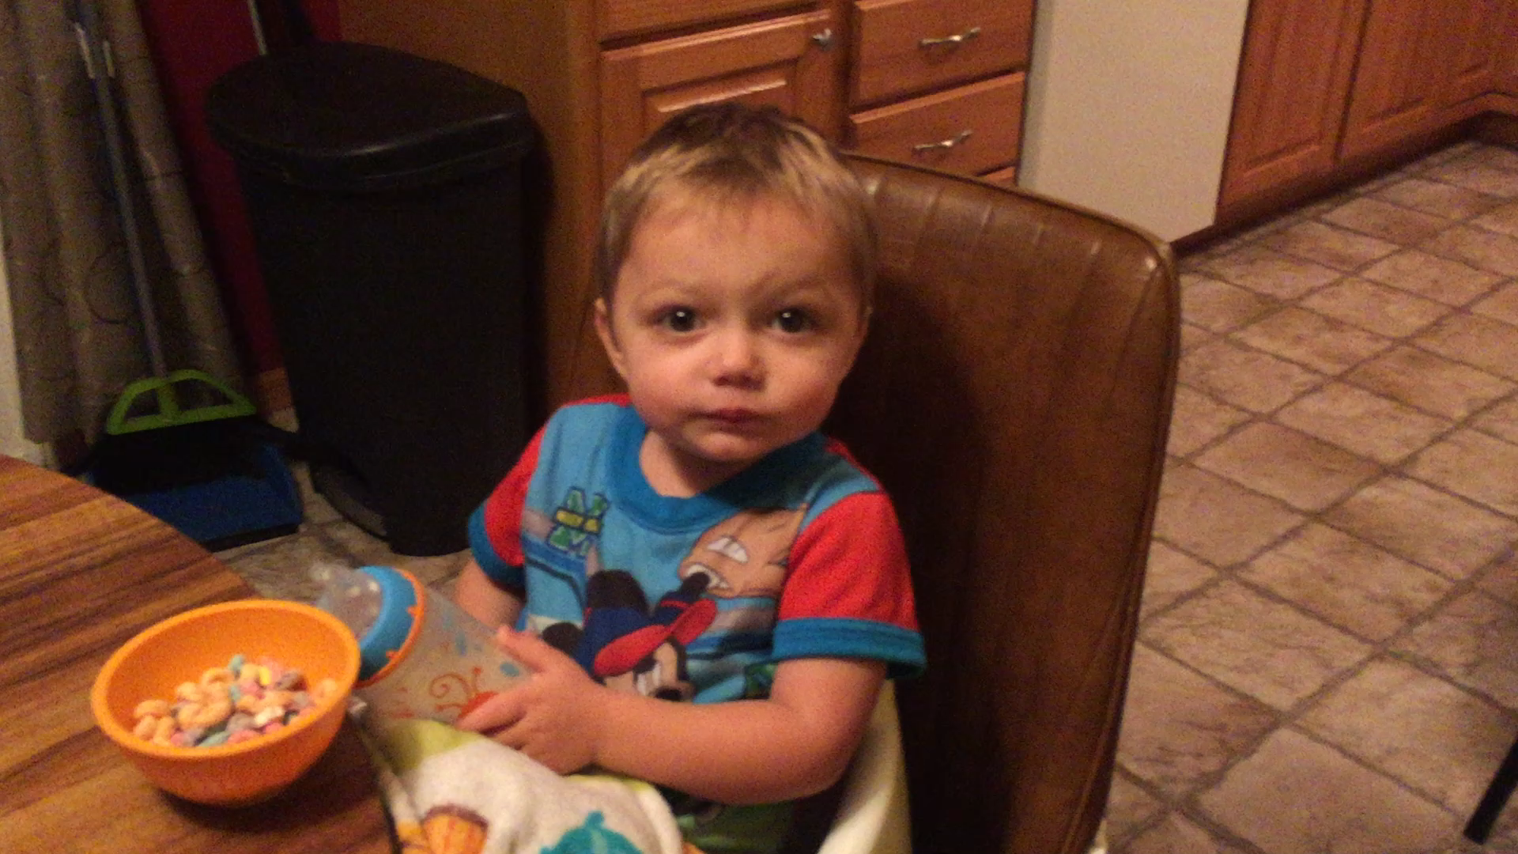
good morning

Slide 3
Introduction
Thane Webb
webbtm@unk.edu
Web Services Coordinator for the University of Nebraska at Kearney
Department of One

Slide 4
when you here accessibility
Introduction
Invokes a lot of reactions. Primarily negative
Mainly because people see it as a daunting task but a necessary one
Accessibility is becoming an even higher priority with the current push in government regulations coming in January 2018.

Slide 5
section 508 changes
Introduction
If you are not aware on January 18, 2017 section 508 of the Rehabilitation Act of 1973 was updated requiring that websites for Federal Agencies meet WICAG guidelines. This doesn’t directly effect most of us but requiring these guidelines for federal agencies means that mandating it for education websites probably isn’t far behind.

Slide 6
My view of accessibility
I used to have the reaction to Accessibility as if it were a dirty word. However, after doing a lot of work on accessibility in the last year I found that it doesn’t have to be.
I found a great tool to help. I have learned a lot more about the subject. I found that accessibility isn’t just about helping viewers with disabilities it helps everyone. Not only does it help everyone but it also has a large effect on search engine optimization.

Slide 7
Key takeaways
Find a good software or tool to help with accessibility
Realize and become comfortable with the fact that accessibility isn’t going to be achieved over night
Understand that Accessibility is an ongoing process not a one time task.
Accessibility doesn’t have to be your 24/7 focus.
The biggest thing that I figured out is don’t look at accessibility in it’s entirety. Look at it in manageable chunks.
  By Issue Type (technical, content editor, etc)
  By Department or Group
  By Importance

Slide 8
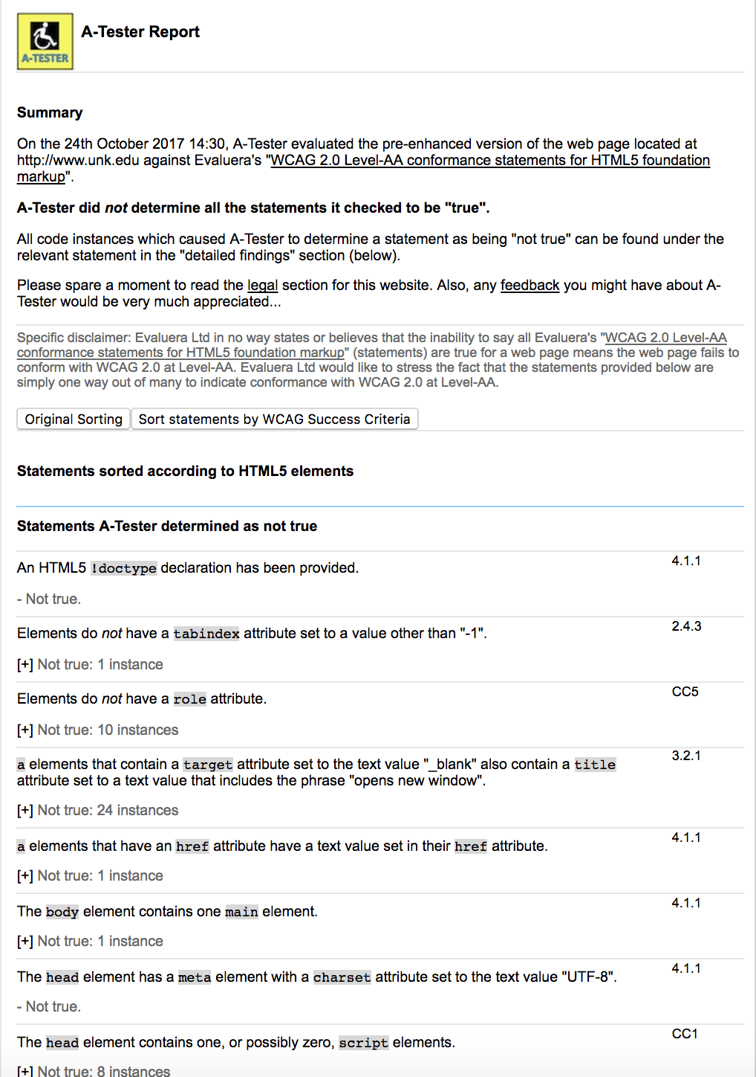

accessibility software / Tools
I think finding a good system or tool to use is huge in getting your site accessible and maintaining it.
We started with free tools
  https://www.w3.org/WAI/ER/tools/
Have to be run on individual pages
Deciphering what you needed to fix based on the reports was difficult. Also the reports never told you why these things were an issue.

Slide 9
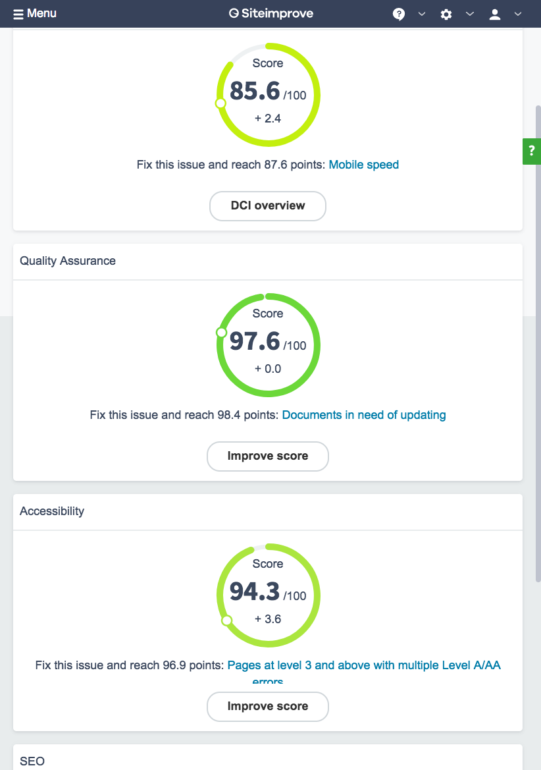
Siteimprove
accessibility software / Tools
We were fortunate in having a little money leftover from one time funds for our website redesign and with that we purchased Siteimprove.
Siteimprove has been amazing it is a one stop shop for all of our website monitoring.
  check and maintain Accessibility
  quality issues (broken links, misspellings, etc)
  search engine optimization
  readability
  Focus currently on Accessibility and Quality assurance, but our next goal is SEO.

Slide 10
Siteimprove
Accessibility Software / Tools
It divides issues by type (technical, content editor, etc.).
Setup groups based off of website directory. So we have folders for academic departments like Biology and Chemistry. So we can work through issues by department.
This also helps us in regards to maintenance because we can see who our worst offenders are for accessibility issues.
We can look at and fix issues by importance

Slide 11
Siteimprove
Accessibility Software / Tools
Siteimprove also helps you learn and teaches about accessibility. It isn’t just a tool that tells you what to fix. They offer free training material and certifications for accessibility as well as other areas.

Slide 12
Siteimprove plugin
Accessibility software / tools
Siteimprove has a free plugin for Google Chrome that allows you to check individual pages for accessibility issues.
Similar to other free systems but it is built into Chrome and the reporting is really easy to understand.
So if you can’t afford to purchase Siteimprove this plugin might be your solution for accessibility checking.

Slide 13
How we are working through our accessibility issues
Started working through based on issue priority or importance. Siteimprove breaks down issues in to 3 areas (error, warning, needs review) under each WICAG level.
Goal to finish all WICAG A and AA errors by January 2018.
Set aside a day a week to work on WICAG A and AA errors. Siteimprove gives you great monitoring of your progress and really helps you feel like you are making progress.
Currently we are at a point where we have hammered through a majority of the A and AA issues so we have started to change focus to a by group/department focus.

Slide 14
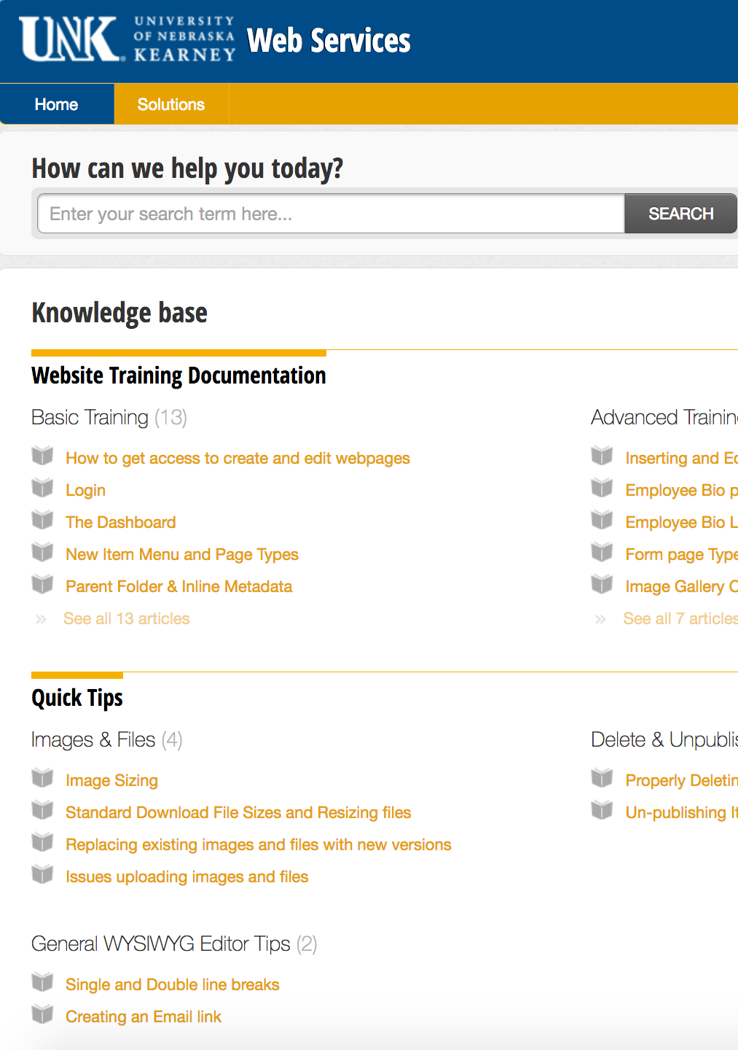
Accessibility for Page editors
Currently we include some accessibility pieces to our trainings.
  Alt text for images
  Image best practices
  Link best practices
We have a searchable web support portal that includes basic accessibility guidelines for web editors.
https://unkwebservices.freshdesk.com/support/home

Slide 15
What’s Next?
Next steps will be to give all our editors access to their respective groups within Siteimprove so they can begin to monitor and up keep their accessibility as well as quality assurance.
We are also going to require that any new department editors take the accessibility certification through Siteimprove before they will be granted access to edit their department webpages. This will be in addition to the mandatory website editor training.
We also plan to require all existing editors to take accessibility certification.
Continue to monitor the entire websites accessibility
In this monitoring we will monitor by department to see who our worst offenders are and follow up with them with the necessary training to prevent issues in the future.
In future redesigns we will thoroughly evaluate accessibility before implementing the design to prevent any technical accessibility issues.

Slide 16
Questions?

